Slide 1
MIDIPainter
Developed by Noah leong

Slide 2
What is midipainter?
A MIDI controller for iOS devices
Uses screen coordinates to send MIDI CC values over USB
The user draws lines, and a circle follows the drawn path to sequence the CC values
Screen coordinates are scaled to MIDI range where the lower right part of the screen is 0, and the upper right corner is 127
When the user touches an existing line, the line is removed and its CC number as well

Slide 3
Why midipainter?
MIDIPainter is largely inspired by Kentaro Suzuki’s M4L device “LFO Sketch”
By combining both the visual and hands on aspect of drawing, MIDIPainter brings a higher level of interaction to the user through the use of touch screen devices.
MIDIPainter is also a handy way of condensing a MIDI controller to handheld devices without the need for large hardware devices

Slide 4
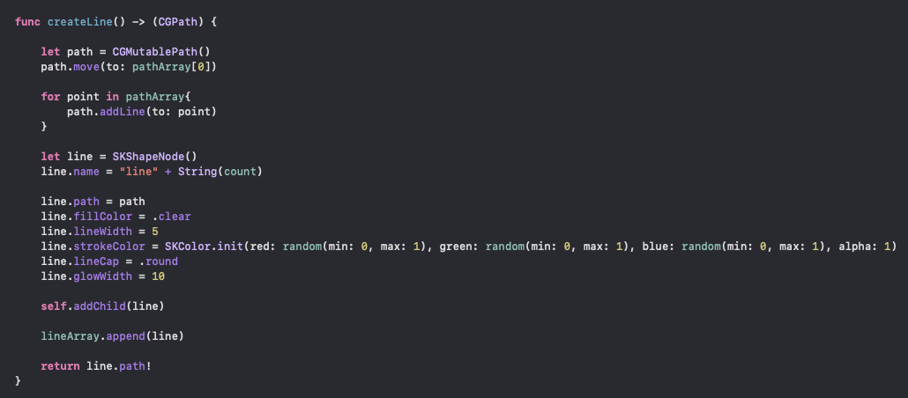
How does it work
MIDIPainter works by creating lines by tracking the user’s touch movements

Slide 5
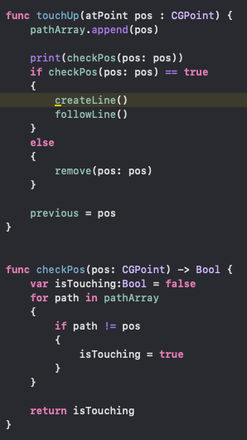
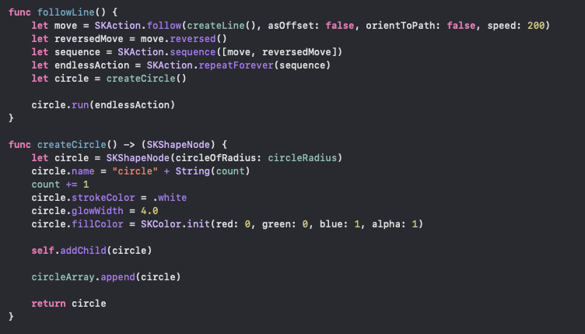
How does it work? Cont.
When a line is created a corresponding circle that follows the line path is also made
When a line an existing line is touched it is removed

Slide 6
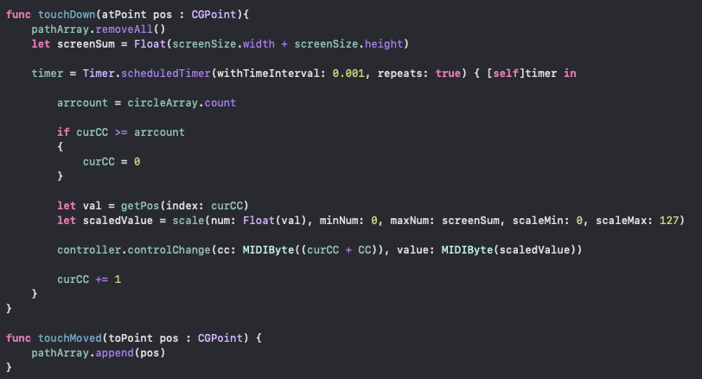
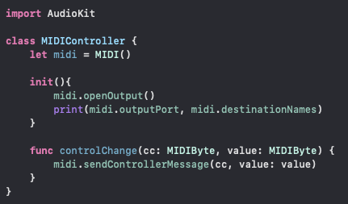
How does it work? Cont.
Values tracked from the circle’s position with the screen are scaled to MIDI range and sent as MIDI CCs

Slide 7
What works?
Line drawing, and circle following works well
Multiple MIDI CCs are sent with their own number corresponding to each circle, along with their own values corresponding to their position
Line removing also works, and removes MIDI CC when done as well
MIDI maps fine in Ableton, along with Max

Slide 8
What doesn’t work
Multitouch functionality doesn’t work (when a user touches with multiple fingers a longer line is drawn with the touched points)
No pause functionality
No speed slider
When a line is removed, MIDI CC numbers after the removed number are pushed down
Tricky to map, when a line is drawn it continuously sends MIDI CCs, making it difficult to map multiple CCs

Slide 9
Additional features
An added tab for sending note messages, complete with quantizers for multiple scales/rhythms
(Modular box design) have quadrants the user can create for multi functionality such as note arpeggiation and MIDI CC in one view
Different brushes and colors for line drawing that the user can choose
More elegant UI design, and a nice icon

